Slide 1
Simulink comments/documentation
are a bit of a mess
many different ways
hard to extract information of all comment types

Slide 2
Simulink Documentation Possibilities
new dimension because of graphical model, not text: blocks (many comments) can have properties:
selected, open
name, name placement, name location, showname
location, height, width
orientation, foregroundcolor, backgroundcolor, shadow
fontangle, fontname, fontsize, fontweight
lots of ways to document/comment in Simulink
classical comments in *.m, Stateflow
I found 9 types of docu/comment
some official suggestions

Slide 3
More commenty
Block description
DocBlock
Annotation
Note

Slide 4
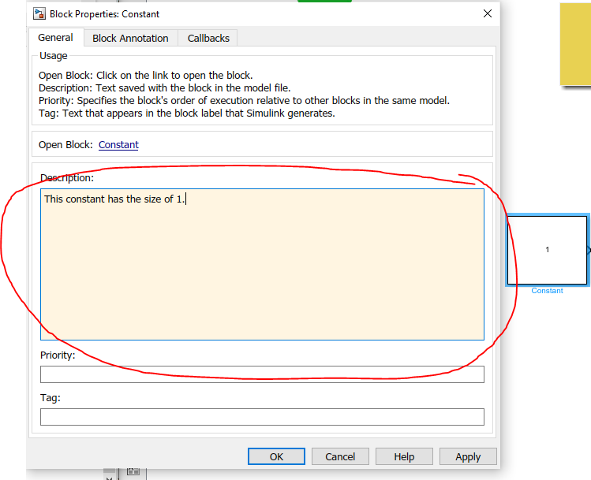
Description of block, parameter, bus, signal
most elements can be described
purpose, inner workings, how to use, find it with a search …
https://www.mathworks.com/help/simulink/ug/block-properties-dialog-box.html

Slide 5
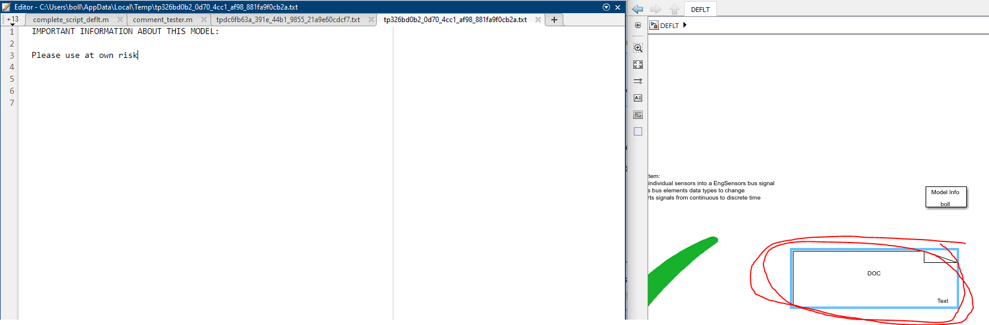
DocBlock
external *.txt/html/rtf in this block
https://www.mathworks.com/help/simulink/slref/docblock.html

Slide 6
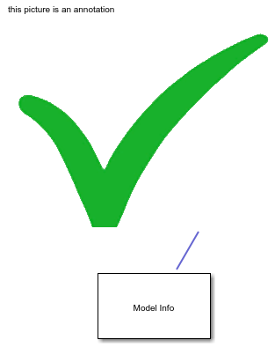

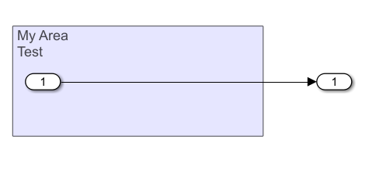
Annotation
text/area/image, possibly linked to blocks
https://www.mathworks.com/help/simulink/ug/annotations.html

Slide 7
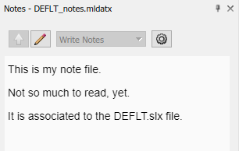
Note
external *.mldatx, associated to model file
programmatically accessible?
read/write mode
possible to follow hierarchy of model: display different info depending on open sub system
https://www.mathworks.com/help/simulink/ug/annotations.html

Slide 8
Less commenty
File meta data
Block description
Block Tag
Mask Display
Viewmark
Report generator

Slide 9
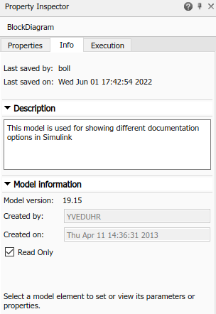
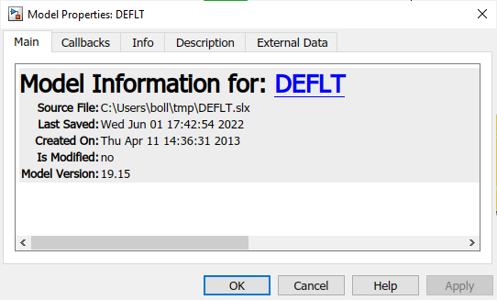
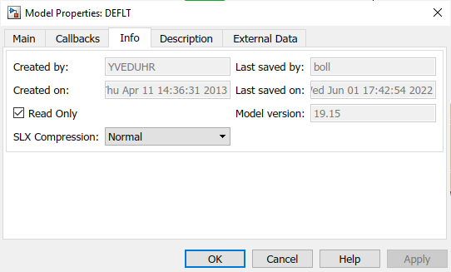
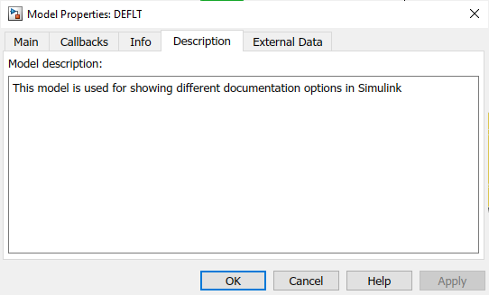
File Meta Data
meta data for whole model
mostly, meta data created by GUI
model description

Slide 10
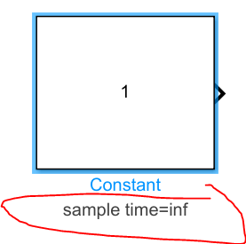
Block Annotation
display specific block parameters of a block
https://www.mathworks.com/help/simulink/ug/block-properties-dialog-box.html

Slide 11
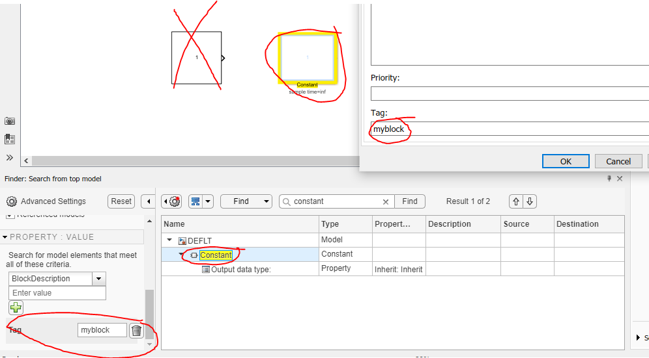
Block Tag
tag blocks for finding specific blocks in the model
https://www.mathworks.com/help/simulink/ug/block-properties-dialog-box.html

Slide 12
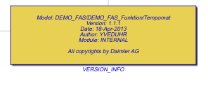
Mask Display
blocks (subsystems can mask their interior)
display comments/meta data on mask

Slide 13
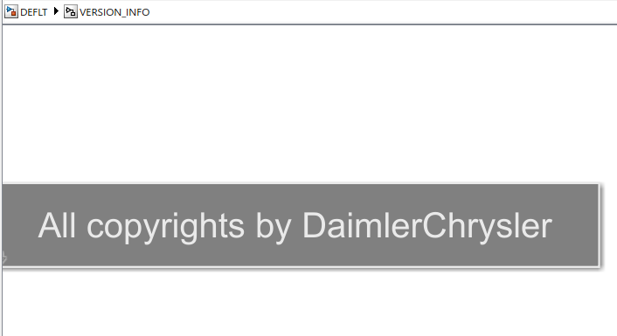
(possible hierarchy)
block inside VERSION_INFO

Slide 14
Simulink Report Generator
have to look this up, for more details
https://www.mathworks.com/products/simulink-report-generator.html

Slide 15
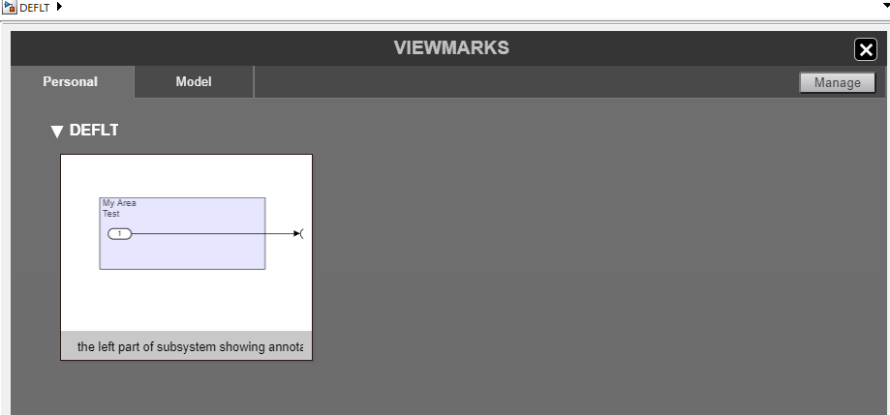
Viewmark
maybe just accessible via GUI?
bookmark views of a model
https://www.mathworks.com/help/simulink/ug/use-viewmarks-to-save-views-of-models.html

Slide 16
Guidelines
comment guidelines for Matlab (not Simulink)
MAB guidelines
Various naming guidelines
model layer shall include a description (format consistent through model)
display project specific+initial block parameters as block annotation
use annotations to mark/describe block groups (area annotation)
Stateflow
comment font/size shall conform to project settings
stateflow comments in C style no newlines, not nested with /* */, else %
comment after action/decision, position consistent
add do-nothing comments, in special cases
don’t use /* */ in *.cgt/mpt files

Slide 17
Preliminary Analysis
In 1118 models (from 100 projects)
94 docblocks
10886 annotations (~1392 unique)
1115 of 1118 models were fully analyzed.
 | min | 5 | 25 | med | 75 | 90 | 95 | 99 | max | ave | std.dev. | num
number_of_subsystems | 0 | 0 | 1 | 4 | 17 | 59 | 163 | 465 | 3227 | 37.5 | 182.07 | 1115
number_of_blocks | 0 | 5 | 17 | 50 | 223 | 637 | 1803 | 3615 | 20446 | 352.46 | 1304.24 | 1115
number_of_signal_lines | 0 | 3 | 17 | 54 | 225 | 684 | 1679 | 3698 | 13654 | 329.67 | 1056.19 | 1115
number_of_docblocks | 0 | 0 | 0 | 0 | 0 | 0 | 0 | 3 | 12 | 0.12 | 0.91 | 1118
number_of_annotations | 0 | 0 | 0 | 1 | 6 | 25 | 51 | 113 | 443 | 9.77 | 31.16 | 1118

Slide 18
From here I could …
Collect and analyze main properties of ...
doc block
annotation
block description
model meta data
block annotation
block tag
mask display
… in ~9000 Simulink models
probably not in …
notes
report generators
viewmarks
(related literature 1, 2)

